Slide 1
Digital Portfolio
STUDENT NAME:R.Karthika
REGISTER NO AND NMID: 24cs27
DEPARTMENT: B.sc.computer science
COLLEGE: Government Arts college Bharathiyar University

Slide 2
PROJECT TITLE
Web page creator

Slide 3


AGENDA
Problem Statement
Project Overview
End Users
Tools and Technologies
Portfolio design and Layout
Features and Functionality
Results and Screenshots
Conclusion
Github Link
3/21/2024 Annual Review

Slide 4

PROBLEM STATEMENT
this project aims to design and develop a personal portfolio website for R. Karthika, which will serve as a digital profile showcasing: Technical skills (C, C++, Java) Completed projects Contact information for professional networking

Slide 5

PROJECT OVERVIEW
1.Skills Section – Displays technical skills including C, C++, and Java, presented in an organized format. 2.Projects Section – Showcases completed projects, such as the portfolio itself and other sample applications, to demonstrate coding expertise.

Slide 6

WHO ARE THE END USERS?
Recruiters / Employers → To check skills & hire.
Faculty / Classmates → For project evaluation.
Clients / Collaborators → For freelance/project opportunities.
General Visitors / Network → To know more & connect.

Slide 7

TOOLS AND TECHNIQUES
Tools: VS Code, Browser, GitHub Techniques: HTML5, CSS3, JavaScript, Responsive Design

Slide 8
POTFOLIO DESIGN AND LAYOUT
Header/Navbar About Skills Projects Contact Footer
8

Slide 9
FEATURES AND FUNCTIONALITY
Future Scope: 1. Add more projects & skills 2. Host online with advanced features Functionality: 1. Show skills & projects 2. Contact form with responsive design

Slide 10
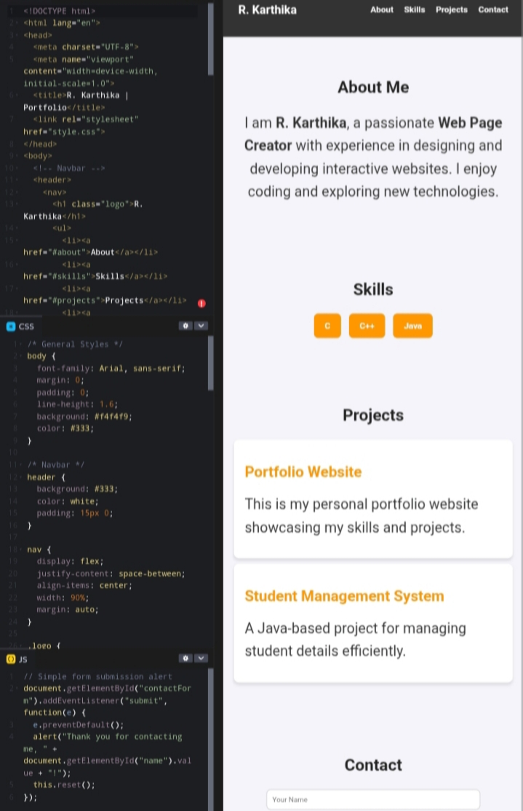

RESULTS AND SCREENSHOTS
3/21/2024 Annual Review
10

Slide 11
CONCLUSION
Portfolio website developed using HTML, CSS, JS. Showcases skills, projects, and contact info. Simple, responsive, and user-friendly. Can be enhanced with more features in future.
11

